Slide 1


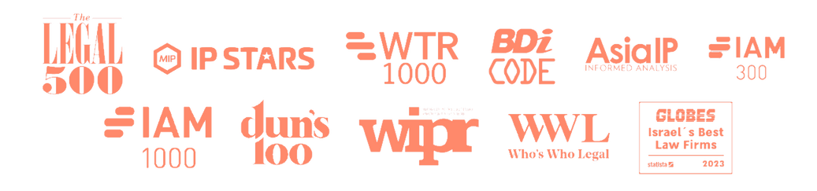
HACKING THE
PATENT
CONUNDRUM
HOW TO GET YOUR PATENT
FILED, OPTIMIZED AND GRANTED
FASTER AND CHEAPER THAN EVER

Slide 2

THE PATENT CONUNDRUM
BR
V1
V1
US/EU/BR
REFUSAL
EU
V1
V1
REFUSAL
US
V1
V1
V1
REFUSAL
V1
V1
REFUSAL
BASIC
FILING
PCT
(12 MONTHS)
NATIONAL PHASE
(30 MONTHS)
  DELAYED FEEDBACK: FIRST EXAMINATION REPORT ARRIVES TOO LATE
  no certainty: national filings before basic filing granted
  Repeated issues: errors carried over to national filings
  Recurring refusals: Facing the same rejections repeatedly
  Costly process: High prosecution expenses for multiple refusals
  Lengthy timeline: Years to get patents registered

Slide 3
THE SOLUTION (ALMOST) NO ONE KNOWS ABOUT
BASIC
FILING
PCT
(12 MONTHS)
NATIONAL PHASE
(30 MONTHS)
AMENDMENT
V1
V1
V2
V2
REFUSAL
V2
GRANTED!
BR
V2
V2
GRANTED!
EU
V2
V2
ISRAEL
US
V2
GRANTED!
V2
GRANTED!
  SUPER FAST: 4 MONTHS TO FIRST REPORT, ACCEPTANCE IN UNDER A YEAR
  Global access: Applicants from any country can file and accelerate
  No translation needed: ILPTO accepts patent applications in English
  Flexible amendments: New matter allowed!
  Optimize filings: Minimize refusals in national applications
  PCT advantage: ILPTO serves as the PCT examining authority
  Accelerate globally: Use ILPTO’s favorable report for national applications

Slide 4
BASIC FILING: WHAT’S THE DIFFERENCE
BR
V1
V1
US/EU/BR
REFUSAL
EU
V1
V1
REFUSAL
US
V1
V1
V1
REFUSAL
V1
V1
REFUSAL
BASIC
FILING
PCT
(12 MONTHS)
NATIONAL PHASE
(30 MONTHS)
AMENDMENT
V1
V1
V2
V2
REFUSAL
V2
GRANTED!
BR
V2
V2
GRANTED!
EU
V2
V2
ISRAEL
US
V2
GRANTED!
V2
GRANTED!

Slide 5
HOW DO WE DO IT?
DRAFT
a killer
1
FILE
application
and
2
accelerate
draft a robust & globally
compatible (incl. US/EPO) patent
application by experienced
patent experts at ~50% of
the standard US pricing
OPTIMIZE
3
for global filing
hop on the
highway
file it with expedited examination
in ILPTO, benefit from super fast examination, unparalleled flexibility
(new matter allowed!) &
software friendly patent regime
PATENT
4
Optimize your patent and get
it granted in under 12 months,
ready for filing well-prepared
PCT/national applications with
patentability validated by a
globally respected Patent Office.
file the patent in US/EPO/China
and any other major Patent Office,
accelerate examination on
Patent Prosecution Highway
(no official fees!) based on
positive examination in Israel

Slide 6
CASE STUDY
REFUSAL
28 NOVEMBER 2019
ACCEPTED!
31 MAY 2020
V1
V1
V2
V2
AMENDMENT
9 MARCH 2020
V2
V2
FAVORABLE REPORT
20 AUGUST 2020
V2
V2
BASIC FILING
GRANTED!
30 JANUARY 2024
ISRAEL
IL267290
12 JUNE 2019
PCT
WO2020/250214
1 JUNE 2020
NATIONAL PHASE
USA
US 11,885,594
20 JUNE 2021
  PATENT APPLICATION WAS AMENDED AND ACCEPTED BEFORE PCT FILING
  amended and accepted version was used for the PCT filing
  PCT application received a favorable patentability report
  amended and accepted version was used for the US national phase filing
  US national phase proceeded to grant smoothly!

Slide 7
WHO WE ARE
  ONE OF ISRAEL’S PREMIER IP LAW FIRMS
  EXPERTISE IN LOCAL AND GLOBAL PATENT AND TRADEMARK PROSECUTION, IP STRATEGY AND IP LITIGATION
  CLIENTS RANGING FROM EARLY-STAGE START-UPS TO UNICORN TECH COMPANIES (MOON ACTIVE, ELEMENTOR AND NAYAX)
  SUCCESFULLY PROSECUTED PATENTS TO GRANT IN FIELDS OF SAAS, CYBER SECURITY, FINTECH, AI, COMPUTER VISION, AGRITECH, TELECOM, MEDICAL DEVICES, CONSUMER PRODUCTS AND INDUSTRIAL MACHINERY
The firm’s practice was RECENTLY recognized by the Legal 500 (Filing and prosecution: Patents, Filing and prosecution: Trademarks and copyrights), Globes Statista (Israel’s best 100 law firms), IP Stars (Trade mark Disputes, Patent Prosecution, Copyright & related rights), IAM 1000 (Patent litigation, Patent prosecution), WTR 1000 (Trademark enforcement and litigation, Trademark transactions), BDI Code (Intellectual Property firms, Patent Attorney firms and Boutique law firms), Asia IP (Patent Prosecution, Copyright) and Dun’s 100 (IP: Litigation, IP: Patent Prosecution).

Slide 8
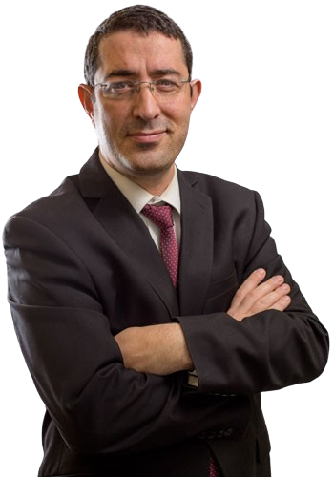
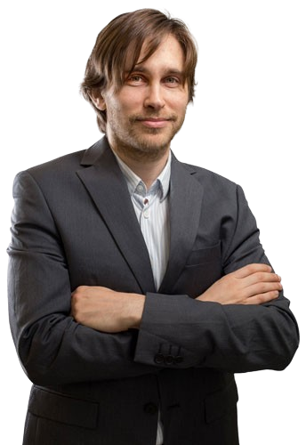
WHO WE ARE
DR. YONATAN DRORI, ADV.
  20 YEARS OF EXPERIENCE IN IP LAW
  PROFESSIONAL BACKGROUND IN SOFTWARE INDUSTRY
  LITIGATED LANDMARK IP CASES
  ADVISED TECH GIANTS ON IP STRATEGY
  ISRAEL’S MOST PROLIFIC AUTHOR OF PROFESSIONAL LITERATURE (5 BOOKS TO DATE)
RECENTLY RECOGNIZED BY WTR1000, WWL, WIPR LEADERS, IP STARS, IAM PATENT 1000, CLIENT CHOICE GUIDE, IAM 300 STRATEGY, THE LEGAL 500 AND ASIA IP AMONG ISRAEL'S LEADING INTELLECTUAL PROPERTY LAW PRACTITIONERS.
IYAR STAV, ADV.
  RICH PATENT DRAFTING AND PROSECUTION EXPERIENCE
  PROFESSIONAL BACKGROUND IN TELECOMMUNICATIONS, CREDIT CARD AND MUSIC INDUSTRIES
  LITIGATED CROSS-BORDER IP CASES
  EXPERTISE IN COPYRIGHT (AUTHOR OF THE WORLD’S MOST CITED ARTICLE ABOUT MUSIC PLAGIARISM IN LAST DECADE)
RECENTLY RECOGNIZED BY IP STARS, WTR 1000, IAM PATENT 1000, IAM 300 STRATEGY, WIPR LEADERS, ASIA IP AND EXPERT GUIDES AMONG ISRAEL'S LEADING INTELLECTUAL PROPERTY LAW PRACTITIONERS.

Slide 9



KEEP IN TOUCH
EMAIL: OFFICE@DWO.CO.IL
TEL: +972-3-6005572
IYAR STAV, ADV. (HEAD OF EUROPEAN OFFICE)
EMAIL: IYAR@DWO.CO.IL
MOBILE (FR): +33-74-44-22-128
MOBILE (IL): +972-52-832-99-24

